Slide 1

DATA INTEGRATION

Slide 2


DATA INTEGRATION
Motivation
Many databases and sources of data that need to be integrated to work together
Almost all applications have many sources of data
Data Integration
Is the process of integrating data from multiple sources and probably have a single view over all these sources
And answering queries using the combined information
Integration can be physical or virtual
Physical: Coping the data to warehouse
Virtual: Keep the data only at the sources

Slide 3











DATA INTEGRATION
Data integration is also valid within a single organization
Integrating data from different departments or sectors
Synthesized Information
CRM Application
Financial Application
Order Management Application
Contract Management Application
Shipping and Distribution Application

Slide 4
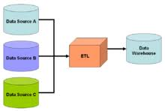

Slide 5
Consider a scenario of library
The item (Book, CD, Magzine) and student data ismaintained in Excel files, whereas the transactional data (Issue and Return) is stored in Access database
The library application would need to integrate all this data and present it in a unified manner to the end user while maintaining the integrity and reliability of data
Data integration would play a vital role in this scenario……

Slide 6
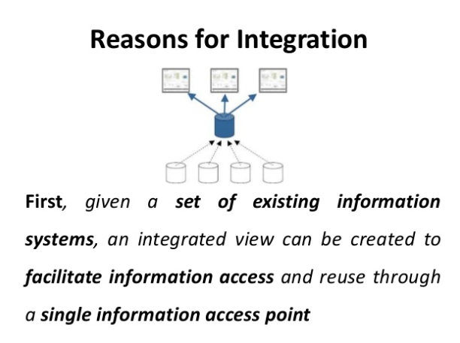

Slide 7
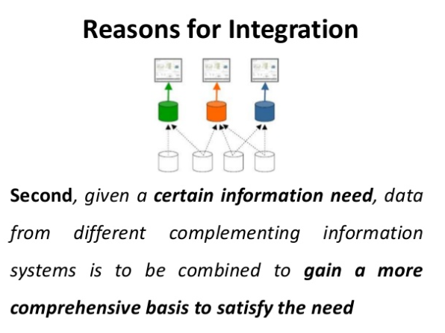

Slide 8
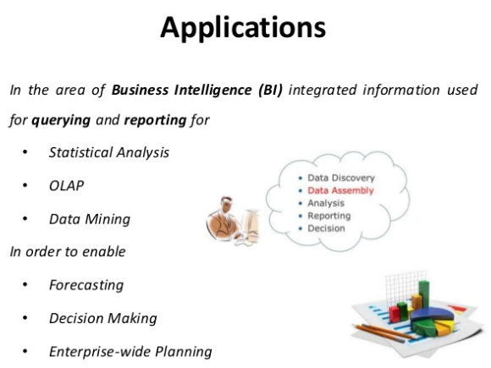

Slide 9
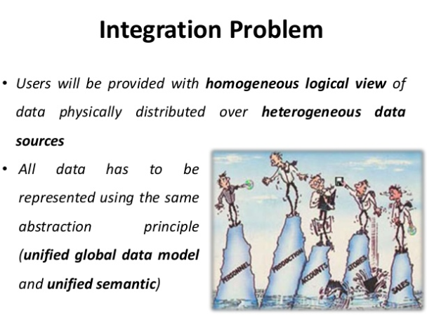

Slide 10



HETEROGENEITY PROBLEMS
The main problem is the heterogeneity among the data sources
Source Type Heterogeneity
Systems storing the data can be different
Relational databases
OO
databases
XML
databases
Other systems

Slide 11


HETEROGENEITY PROBLEMS
Communication Heterogeneity
Some systems have web interface others do not
Some systems allow direct query language others offer APIs
Schema Heterogeneity
The structure of the tables storing the data can be different (even if storing the same data)
Customers (ID, firstName, lastName, homePhone, cellPhone, …)
Customers (ID, FullName, …)
CustomersPhones (ID, Type, PhoneNum)

Slide 12
HETEROGENEITY PROBLEMS
Data Type Heterogeneity
Storing the same data (and values) but with different data types
E.g., Storing the phone number as String or as Number
E.g., Storing the name as fixed length or variable length
Value Heterogeneity
Same logical values stored in different ways
E.g., ‘Prof’, ‘Prof.’, ‘Professor’
E.g., ‘Right’, ‘R’, ‘1’ ……… ‘Left’, ‘L’, ‘-1’

Slide 13

HETEROGENEITY PROBLEMS
Semantic Heterogeneity
Same values in different sources can mean different things
E.g., Column ‘Title’ in one database means ‘Job Title’ while in another database it means ‘Person Title’
Data integration has to deal with all such issues and more

Slide 14



REASONS OF HETEROGENEITY
Schemas
Generalization Specialization
Aggregation
Typing
Completeness
Structural
Model
Taxonomy
Syntactical
Data "Conflicts"
Semantic
Values
Language
Cognitive

Slide 15

COMMON APPROACHES OF DATA INTEGRATION
1) Federated Databases
2) Data Warehousing
3) Mediation

Slide 16

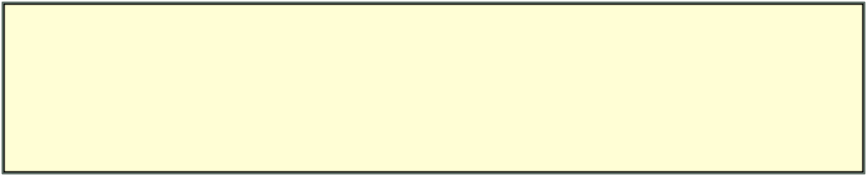
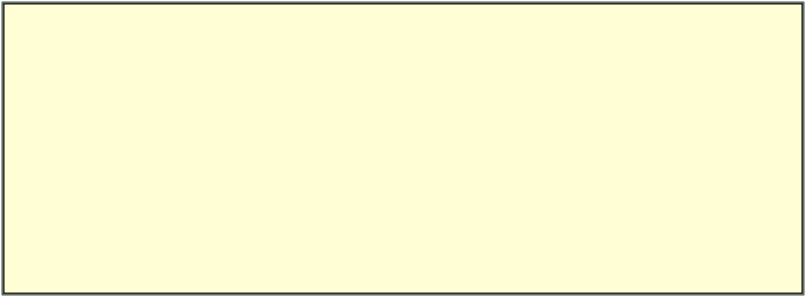

FEDERATED DATABASES
Simplest architecture
Every pair of sources can build their own mapping and transformation
Source X needs to communicate with source Y →→ build a mapping between X and Y
Does not have to be between all sources (on demand)
Advantages
1- if many sources and only very few are communicating
Disadvantages
1- if most sources are communicating (n² mappings)
+$%,,"$
+$%,,"$
+$%,,"$
+$%,,"$
+$%,,"$
+$%,,"$
2- If sources are dynamic (need to change many mappings)

Slide 17
FEDERATED DATABASES
A system in which each server is autonomous and centralized DBMS that has its own local users. The term Federated Database system or in short FDS is basically used when there is some global view or schema of the Federation of the database which is basically shared by the applications. These systems are hybrid between distributed and centralized systems.
Issues in FDBMS – In heterogeneous FDBMS one server may be network DBMS or an object DBMS or else a relational or hierarchical DBMS in such cases we may need to have canonical language system and which include language translators to translate subqueries from the canonical language to the language of the server. The type of heterogeneity present in FDBMS may arise basically from several sources.

Slide 18
Following types of Heterogeneity or Issues will occur in FDBMS.
Differences in data model – In an organization, we may have different types of the data model for databases such as relational, file, object data model and modeling capabilities of these models vary from one another. Hence to deal with them uniformly in a single language is too challenging. Hence Difference in the data model is the basic issue in FDBMS.
Difference in Constraints – Constraints facilities and its implementation vary from one system to another. There are basically comparable features that must be reconciled in the basic construction of global schema. And this global schema also has to deal with potential conflicts among constraints. For example, the relationship from the ER model is represented as referential integrity constraint in the relational model.
Difference in Query Language – For the same data model, we have so many languages and their version also varies. For example, even in SQL, we have so many versions such as SQL-89, SQL-92 and SQL-99 and these versions have their own set of data types, comparison operators, string manipulation and so on.

Slide 19
DATA FEDERATION IN BREIF
databases in a central repository without the need to copy them
• Very fast data access
• Flexible change of virtual views
• Virtual data integrati enables extreme agility and reduces buildtimes/costs
• Limited scalability (e.g. unable to support many simultaneous users)
• Caching repositories cause performance problems

Slide 20
Virtual Data Integration Architecture
Mediated Schema
Query reformulation
or Warehouse
/
Query over materialized data
Source
descriptions
/
Transforms
Wrapper
/
Wrapper
/
Wrapper
/
Wrapper
/
Extractor
Extractor
Extractor
Extractor
RDBMS
RDBMS
1
2
HTML
XML
1
1
Notes:
The one-slide overview of data integration.
You start with a bunch of sources. These can be forms on the web; databases in an enterprise; collections of data in a big science project, or databases in the military or government. They can also be truck parts for a major truck company.
You build wrappers. Won’t talk much about those. But then you put the semantic mappings. These things tell you the relationships between the schemas of the sources and those of the mediated schema. They’re often called ‘source descriptions’ too.
At run-time, you precede the optimization and execution by a reformulation step. That’s when you use the source descriptions to take the query from the mediated schema, decide which sources are relevant, and pose appropriate queries on the sources, and combine the results appropriately.

Slide 21
Example
Movie
(
title
,
director
,
year
,
genre
)
Actors
(
title
,
actor
)
Plays
(
movie
,
location
,
startTime
)
Reviews
(
title
,
rating
,
description
)
S
1
S
2
S
3
S
4
S
5
CinemasInNYC
CinemasInSF
Reviews
(
Movies
Cinemas
title
,
(
name
,
(
place
,
(
cinema
,
title
,
(
actors
location
,
movie
,
date
,
grade
,
,
director
,
movie
,
start
)
startTime
)
startingTime
)
review
genre
)
)
Notes:
The one-slide overview of data integration.
You start with a bunch of sources. These can be forms on the web; databases in an enterprise; collections of data in a big science project, or databases in the military or government. They can also be truck parts for a major truck company.
You build wrappers. Won’t talk much about those. But then you put the semantic mappings. These things tell you the relationships between the schemas of the sources and those of the mediated schema. They’re often called ‘source descriptions’ too.
At run-time, you precede the optimization and execution by a reformulation step. That’s when you use the source descriptions to take the query from the mediated schema, decide which sources are relevant, and pose appropriate queries on the sources, and combine the results appropriately.

Slide 22

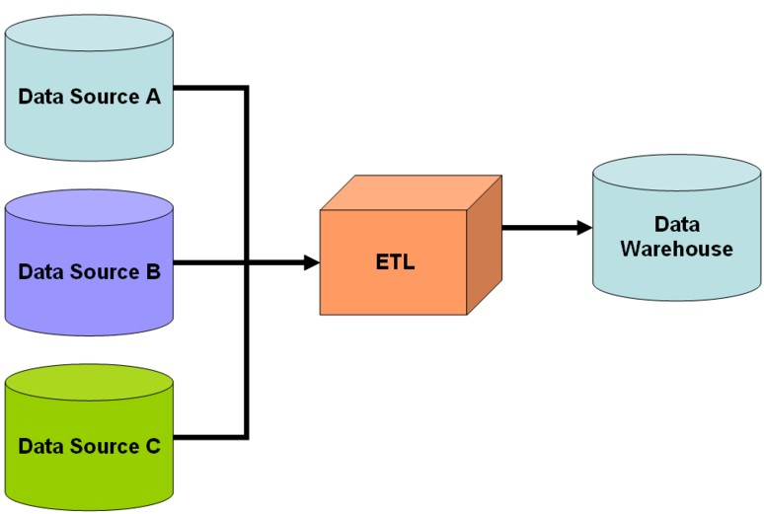
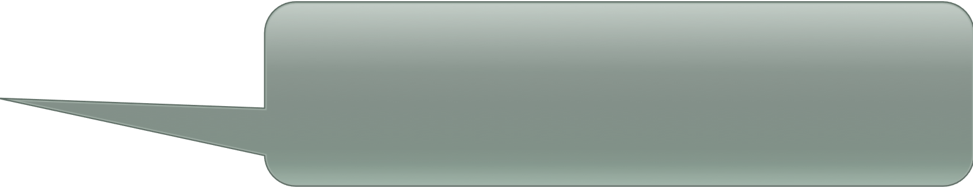
DATA WAREHOUSING
Very common approach
Data from multiple sources are copied and stored in a warehouse
Data is materialized in the warehouse
Users can then query the warehouse database only
ETL: Extract-Transform-Load process
ETL is totally performed outside the warehouse
Warehouse only stores the data

Slide 23
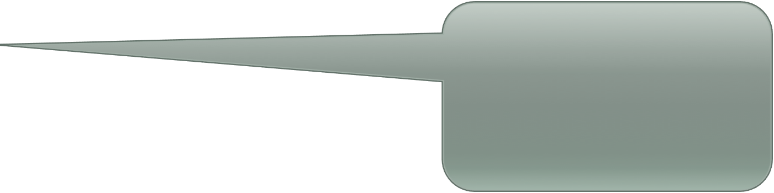
DATA WAREHOUSING: SYNCHRONIZATION
How to synchronize the data between the sources and the warehouse???
Two approaches
Complete rebuild
In both approaches the warehouse is not up-to-date at all times
Periodically re-build the warehouse from the sources (e.g., every night or every week)
(+) The procedure is easy
(-) Expensive and time consuming
Incremental update
Periodically update the warehouse based on the changes in the sources
(+) Less expensive and efficient
(-) More complex to perform incremental update
(-) Requires sources to keep track of their updates

Slide 24

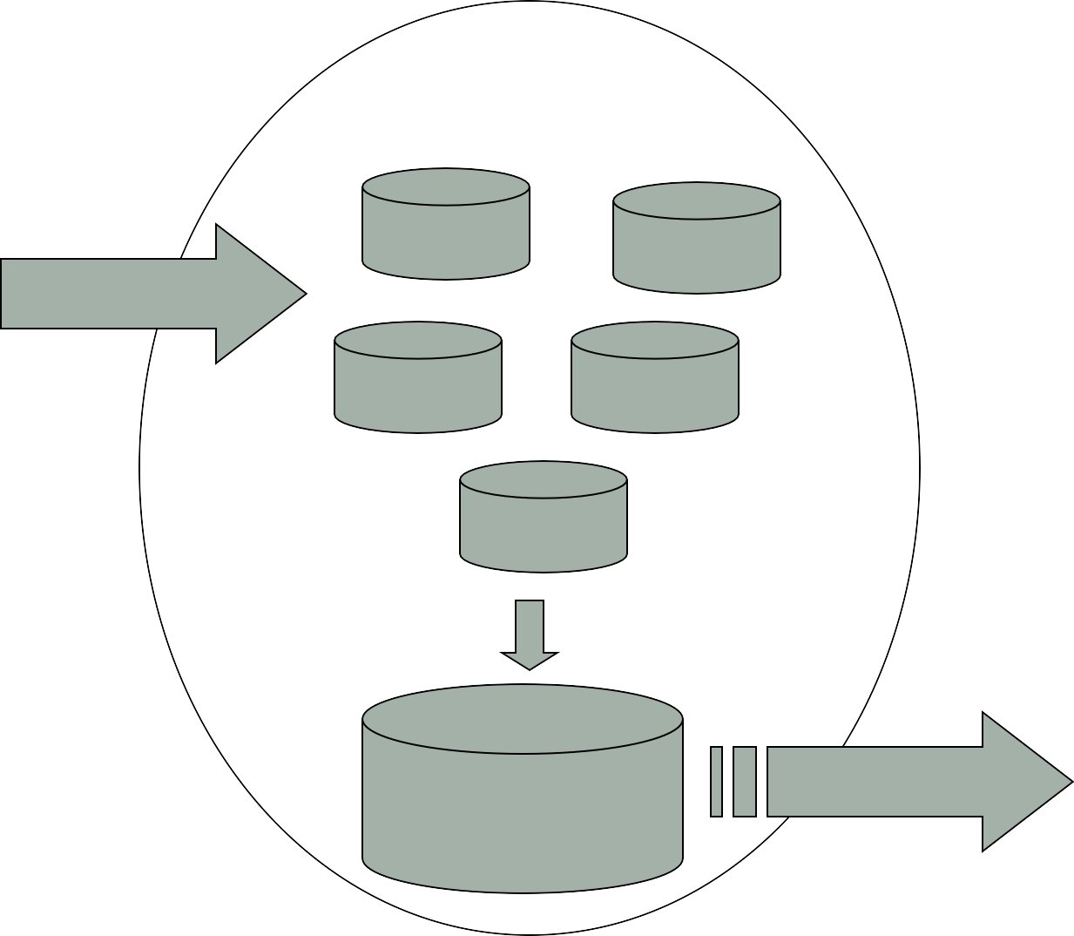
DATA WAREHOUSING
Enterprise
“Database”
Simple queries
Customers
Orders
Transactions
Vendors
Etc…
Etc…
Copied, organized summarized
Complex and OLAP queries
Data Warehouse
Data Mining

Slide 25









TRADITIONAL DW ARCHITECTURE
OLAP
Server
OLAP
Internal Sources
Data Integration Component
Query and Analysis Component
Reports
Data
Warehouse
Operational DBs
Data Mining
Meta data
External Sources
Client Tools

Slide 26

MEDIATION
Mediator is a virtual view over the data (it does not store any data)
Data is stored only at the sources
23$* 4.$*5
7$3.8(
#$%&'()*
Mediator has a virtual schema that combines all schemas from the sources
6.$*5
7$3.8(
7$3.8(
6.$*5
+*',,$*
+*',,$*
The mapping takes place at query time
This is unlike warehousing where mapping takes place at upload time
6.$*5 7$3.8(
-).*/$ 0
6.$*5 7$3.8(
-).*/$ 1

Slide 27



MEDIATION: DATA MAPPING
23$* 4.$*5
7$3.8(
#$%&'()*
6.$*5
7$3.8(
7$3.8(
6.$*5
+*',,$*
+*',,$*
6.$*5 7$3.8(
-).*/$ 0
6.$*5 7$3.8(
-).*/$ 1
Given a user query
Query is mapped to multiple other queries
Each query (or set of queries) are sent to the sources
Sources evaluate the queries and return the results
Results are merged (combined) together and passed to the end-user

Slide 28



MEDIATION: EXAMPLE
Mediator Schema
Cust (ID, firstName, LastName, …)
CustPhones (ID, Type, PhoneNum, …)
Source 1 Schema
Customers (ID, firstName, lastName, homePhone, cellPhone, …)
Source 2 Schema
Customers (ID, FullName, …)
CustomersPhones (ID, Type, PhoneNum)
What if we need, first name, last name, and cell phone of customer ID =100?

Slide 29






MEDIATION: EXAMPLE
Mediator Schema
Cust (ID, FirstName, LastName, …)
CustPhones (ID, Type, PhoneNum, …)
Select C.FirstName, C.LastName, P.PhoneNum From Cust C, CustPhones P
Where C.ID = P.ID And C.ID = 100
And P.Type = “celll”;
Map to source 1
Select firstName, lastName, cellPhone From Customers
Where C.ID = 100;
Source 1 Schema
Customers (ID, firstName, lastName, homePhone, cellPhone, …)

Slide 30



MEDIATION: EXAMPLE
Mediator Schema
Cust (ID, FirstName, LastName, …)
CustPhones (ID, Type, PhoneNum, …)
Select C.FirstName, C.LastName, P.PhoneNum From Cust C, CustPhones P
Where C.ID = P.ID And C.ID = 100
And P.Type = “celll”;
Function that returns the first name
Map to source 2
Select First(C.FullName), Last(C.FullName),
P.PhoneNum
From Customers C, CustomersPhones P Where C.ID = P.ID
And C.ID = 100
And P.Type = “celll”;
Source 2 Schema
Customers (ID, FullName, …)
CustomersPhones (ID, Type, PhoneNum)

Slide 31
MEDIATION: WRAPPERS
Usually wrappers are the components that perform the mapping of queries
One approach is to use templates with parameters
If the mediator query matches a template, then replace the parameters and execute the query
If no template is found, return empty results
23$* 4.$*5 7$3.8(
#$%&'()*
Designing these template is a complex process because they need to be flexible and represent many queries
6.$*5
7$3.8(
7$3.8(
6.$*5
+*',,$*
+*',,$*
6.$*5 7$3.8(
-).*/$ 0
6.$*5 7$3.8(
-).*/$ 1

Slide 32

MEDIATOR TYPES
Global As View (GAV)
Local As View (LAV)

Slide 33
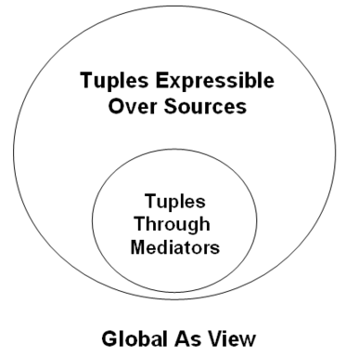

GLOBAL AS VIEW (GAV)
Mediator schema acts as a view over the source schemas
Rules that map a mediator query to source queries
Like regular views, what we see through the mediator is a subset of the available world
-- Limited view over the data
-- Cannot integrate/combine data from multiple sources to create new data beyond each source
22

Slide 34

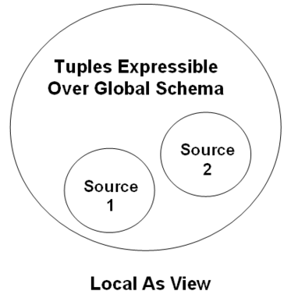
LOCAL AS VIEW
Sources are defined in terms of the global schema using expression
Every source provides expressions on how it can generate pieces of the global schema
Mediator can combine these expressions to find all possible ways to answer a query
-- Covers more data beyond each source individually
-- more complex than GAV
23

Slide 35








WHAT WE COVERED SO FAR …
Data integration is the process of integrating data from multiple sources And answering queries using the combined information
+$%,,"$
Models of Data Integration
Federated Database
+$%,,"$
+$%,,"$
+$%,,"$
+$%,,"$
+$%,,"$
Data Warehouse
Mediators
Global As View (GAV)
Local As View (LAV)
23$* 4.$*5
7$3.8(
#$%&'()*
6.$*5
7$3.8(
7$3.8( 6.$*5
+*',,$*
+*',,$*
6.$*5 7$3.8(
-).*/$ 0
6.$*5 7$3.8(
-).*/$ 1
28

Slide 36









AUTOMATED DATA INTEGRATION
Data integration requires a lot of manual effort
Data warehouse →→ designing and implementing the ETL module
Mediators →→ designing and implementing the wrappers
Federated database →→ designing and implementing the mapping modules (wrappers)
23$* 4.$*5
7$3.8(
+$%,,"$
#$%&'()*
+$%,,"$
6.$*5
7$3.8(
+$%,,"$
+$%,,"$
7$3.8(
6.$*5
+$%,,"$
+*',,$*
+*',,$*
+$%,,"$
6.$*5 7$3.8(
-).*/$ 0
6.$*5 7$3.8(
-).*/$ 1
Can we automate this process ???
36

Slide 37





WORK IN PROGRESS + RECENT RESEARCH
A Generic Framework for Integration
Source schemas
mapping rules
schemas transformation
correspondences investigation
schemas integration
integrated schema
transformation rules
investigation rules
integration rules
Consider several database schemas for different bookstores
How to match their schemas automatically ←← schema matching techniques
How to find matching records ←← record linkage techniques
How to find errors, synonyms, etc. and correct them ←← data cleansing techniques
37

Slide 38
Data Mart
Data marts contain a subset of organization-wide data that is valuable to specific groups of people in an organization. In other words, a data mart contains only those data that is specific to a particular group. For example, the marketing data mart may contain only data related to items, customers, and sales. Data marts are confined to subjects.
Points to Remember About Data Marts
Windows-based or Unix/Linux-based servers are used to implement data marts. They are implemented on low-cost servers.
The implementation cycle of a data mart is measured in short periods of time, i.e., in weeks rather than months or years.
The life cycle of data marts may be complex in the long run, if their planning and design are not organization-wide.
Data marts are small in size.
Data marts are customized by department.
The source of a data mart is departmentally structured data warehouse.
Data marts are flexible.

Slide 39
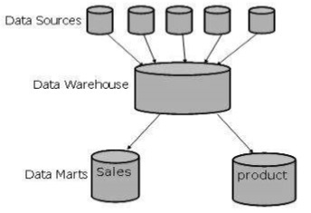

Slide 40
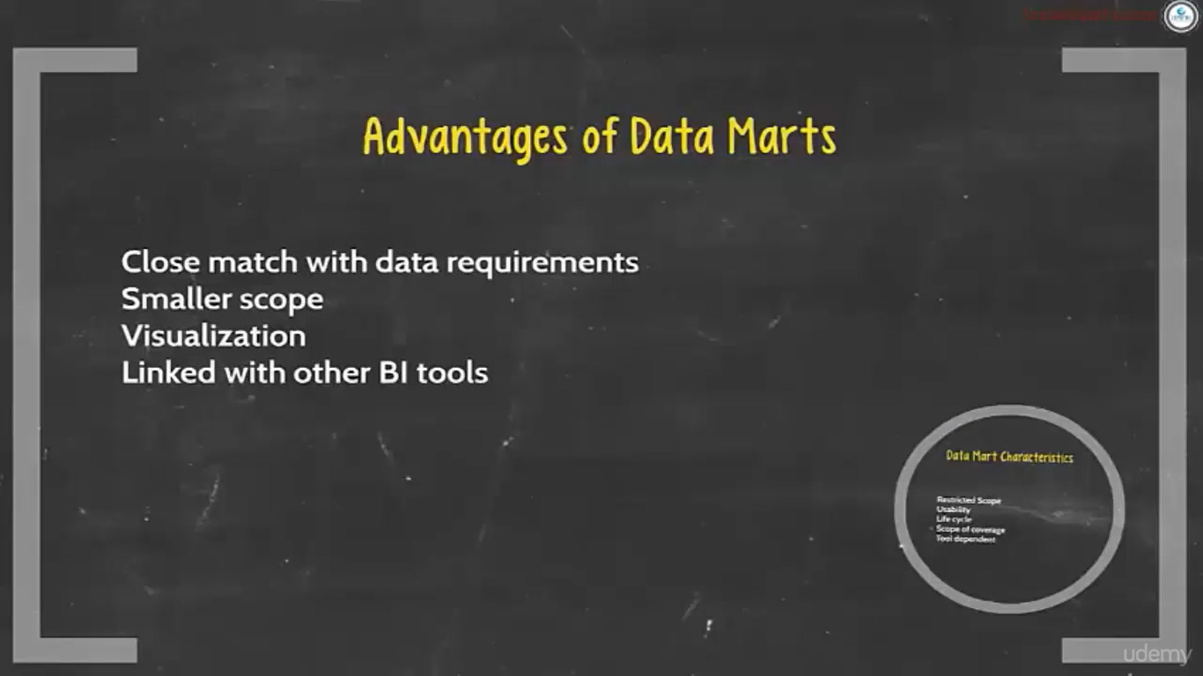

Slide 41
Data Quality
Data quality refers to the state of qualitative or quantitative pieces of information.
There are many definitions of data quality but data is generally considered high quality if it is "fit for [its] intended uses in operations, decision making and planning".
Moreover, data is deemed of high quality if it correctly represents the real-world construct to which it refers.
Furthermore, apart from these definitions, as the number of data sources increases, the question of internal data consistency becomes significant, regardless of fitness for use for any particular external purpose.
data cleansing, including standardization, may be required in order to ensure data quality.
data quality can be defined as the degree to which a set of characteristics of data fulfills requirements.
Examples of characteristics are: completeness, validity, accuracy, consistency, availability and timeliness.

Slide 42
The market is going some way to providing data quality assurance. A number of vendors make tools for analyzing and repairing poor quality data in situ, service providers can clean the data on a contract basis and consultants can advise on fixing processes or systems to avoid data quality problems in the first place.
Most data quality tools offer a series of tools for improving data, which may include some or all of the following:
1) Data profiling - initially assessing the data to understand its current state, often including value distributions
2) Data standardization - a business rules engine that ensures that data conforms to standards
3) Geocoding - for name and address data. Corrects data to U.S. and Worldwide geographic standards
4) Matching or Linking - a way to compare data so that similar, but slightly different records can be aligned. Matching may use "fuzzy logic" to find duplicates in the data. It often recognizes that "Bob" and "Bbo" may be the same individual.
5) Monitoring - keeping track of data quality over time and reporting variations in the quality of data. Software can also auto-correct the variations based on pre-defined business rules.
6) Batch and Real time - Once the data is initially cleansed (batch), companies often want to build the processes into enterprise applications to keep it clean

Slide 43
Data quality assurance
Data quality assurance is the process of data profiling to discover inconsistencies and other anomalies in the data, as well as performing data cleansing^{[17][18]} activities (e.g. removing outliers, missing data interpolation) to improve the data quality.
These activities can be undertaken as part of data warehousing or as part of the database administration of an existing piece of application software

Slide 44
Data quality control
Data quality control is the process of controlling the usage of data for an application or a process. This process is performed both before and after a Data Quality Assurance (QA) process, which consists of discovery of data inconsistency and correction.
Before:
Restricts inputs
After QA process the following statistics are gathered to guide the Quality Control (QC) process:
Severity of inconsistency
Incompleteness
Accuracy
Precision
Missing / Unknown
The Data QC process uses the information from the QA process to decide to use the data for analysis or in an application or business process. General example: if a Data QC process finds that the data contains too many errors or inconsistencies, then it prevents that data from being used for its intended process which could cause disruption. Specific example: providing invalid measurements from several sensors to the automatic pilot feature on an aircraft could cause it to crash. Thus, establishing a QC process provides data usage protection

